Slide 1
MACHINE LEARNING
A CASE STUDY

Slide 2
PILOT PROJECT: PREDICT SURVIVAL ON THE TITANIC
THE PROBLEM
Analysis of passengers that were likely to survive (or die) in the infamous sinking of the Titanic. In particular, to apply the tools of machine learning to predict which passengers survived the tragedy.

Slide 3
THE DATA
Training set
Passenger ID
Survival classification (o or 1)
Passenger class (3,2 or 1)
Name
Sex
Age
Siblings (if any) aboard
Parent-children aboard
Ticket number
Passenger Fare
Cabin
Port of embarkation

Slide 4
INTUITIONS
Choosing the features to train a model is one of the most vital parts of solving a machine learning problem. Here we are given 11 features for each labelled training example. Our first step is to choose the relevant features, which we believe, will affect the survival of the people on the ill-fated boat.
Passenger ID – These are more or less random in nature and shouldn’t really affect the chances of survival
Age – It is reasonable to believe that age played a major role in determining whether a person survived the disaster or not. This is because women and children are evacuated first in such events.
Sex – This is also a crucial feature in predicting the outcome for the same reason mentioned above.

Slide 5
INTUITIONS
FEATURE
RELEVANCE
SIBLINGS ABOARD
PARENT/CHILDREN ABOARD
FARE
It is reasonable to believe that if a person had siblings aboard, they would leave together or not at all.
Relevant feature for the same above-mentioned reason.
People holding costlier tickets may be more likely to survive as they may hold higher positions in society and could influence the authorities decision on the ship during the calamity.

Slide 6
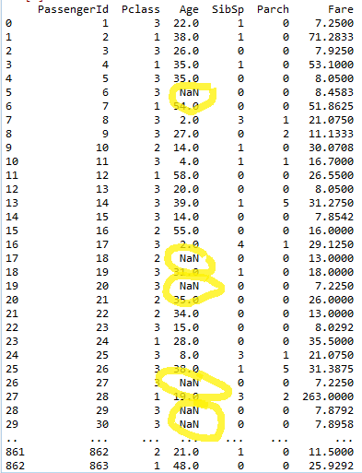
VISUALIZING DATA
Once we have chosen the features, we need to look at the data that we currently have. It’s clear that the “Age” column has a few NaN or ‘missing’ values. This needs to be fixed, before we fit any model to the data.

Slide 7
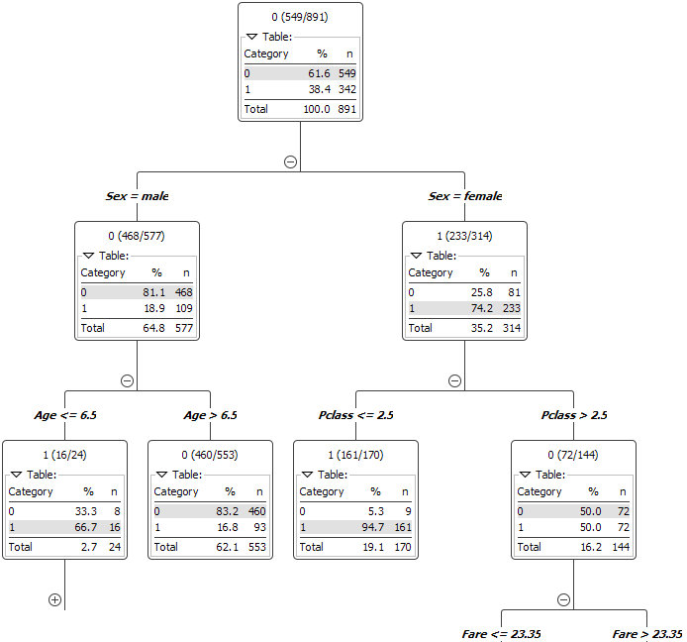
FITTING THE MODEL
Once the data has been ‘cleaned’, it is now possible to fit a model to make predictions. For this case, we choose an ensemble decision tree model called Random Forest. It has a number of tuning parameters such as: Number of trees, Depth, Number of records per node etc.. Choosing one set of tuning parameters we can get a forest that looks like this.

Slide 8
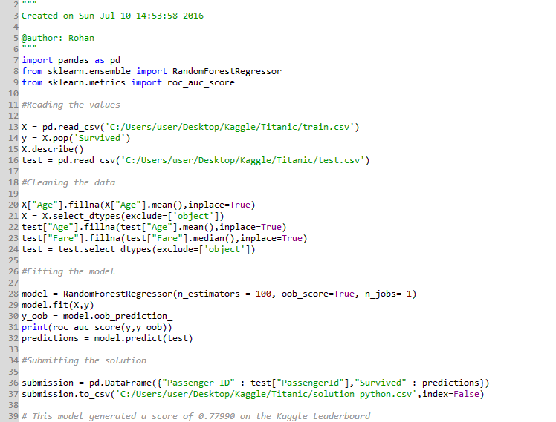
PYTHON CODE
This model gave a LeaderBoard(LB) score of 0.77990 on Kaggle. Playing with the tuning parameters and better feature selection could easily generate scores up to 0.86 on the LB for this problem.

Slide 9
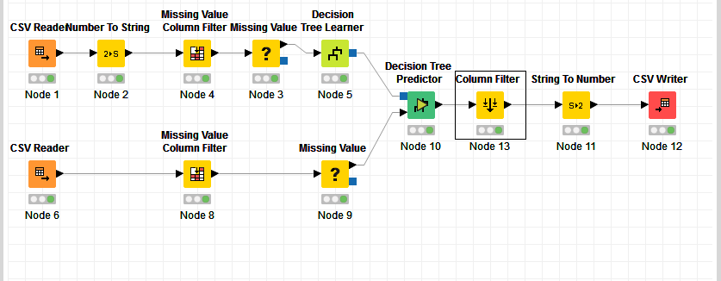
KNIME WORKSPACE
KNIME workspace using Random Forest.

Slide 10
DEMONSTRATION PROJECT: GRUPO BIMBO INVENTORY DEMAND
THE PROBLEM
To develop a model to accurately forecast inventory demand based on historical sales data. Doing so will make sure consumers of Grupo BIMBO’s over 100 bakery products aren’t staring at empty shelves, while also reducing the amount spent on refunds to store owners with surplus product unfit for sale.

Slide 11
THE DATA
Training set
Semana (week number)
Agencia_id – sales depot id
Canal_id – channel_id
Ruta-sak - route
Cliente_id – client id
Producto_id – product id
Venta_uni_hoy – sales this week (int)
Venta_hoy – sales this week (pesos)
Dev_uni_proxima – returns next week (int)
Dev_proxima – returns next week (pesos)
Demanda_uni_equil – demand (to be predicted)

Slide 12
INTUITIONS
The Dataset for this problem is very large. The training set is a CSV file that takes up around 3.5 Gigabytes of memory! Therefore, the computing cost for such a problem is exponentially higher than the previous problem. Care must be taken to choose features wisely to save computational costs and time.
For all the models described henceforth, the following features were chosen to train the model.

Slide 13
INTUITIONS
FEATURE
RELEVANCE
SEMANA
PRODUCTO_ID
CLIENTE_ID
AGENCIA_ID
RUTA_SAK
Week number might be useful as with each successive week, the weather changes and so do people’s choices in food.
Demand for a product relies heavily on the product itself.
The demand from a particular client may be more/less depending on the population of the area.
One sales depot might be preferred over another because of trends in the market.
Routes affect the delivery of perishable and non-perishable items.

Slide 14
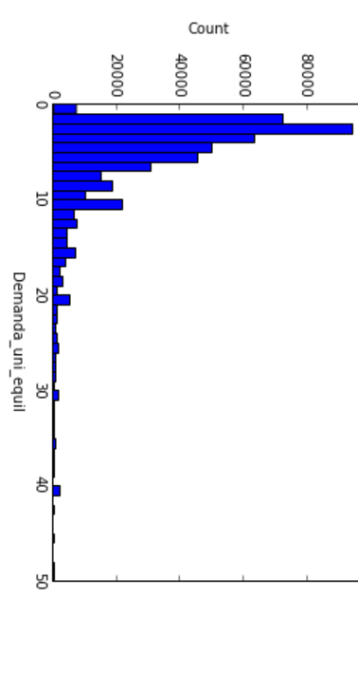
MODEL 1: MODE
The first step to solving an ML problem is to quickly develop a model without putting a lot of thought into the parameters, features, etc.. This serves to set a benchmark score for all the future models and gives a ‘feel’ of the dataset.
For this model, we compute the modal value of the demand column in the training set and set that value as the demand for each test example. This simple solution can be argued to be too naïve, but it does the job of setting a benchmark score.

Slide 15
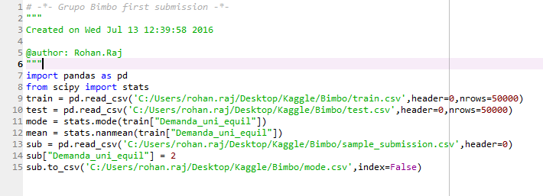
PYTHON CODE FOR MODEL 1
This model generated an LB score of 0.96080. There is a lot of room for improvement.

Slide 16
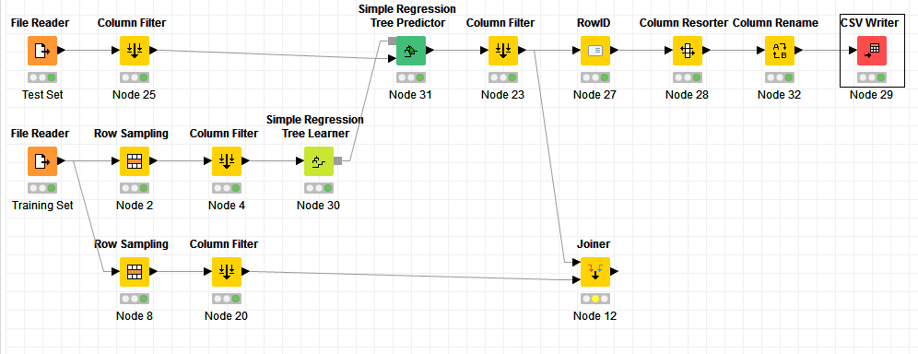
MODEL 2: SIMPLE REGRESSION TREE
It was extremely time-consuming to train models on the entire dataset, so a number of training examples were randomly chosen from the training set. This model used 50,000 randomly selected training examples. Generated a score of 0.91093. Still needs work.

Slide 17
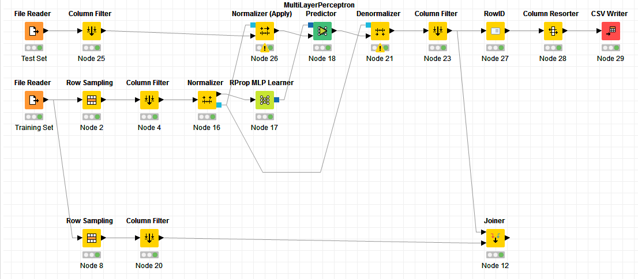
MODEL 3: NEURAL NETWORKS
For this model, 1,00,000 training examples were randomly chosen from the training set to learn parameters. Number of hidden layers = 1; Number of neurons = 10. Generated a LB score of 0.89458.

Slide 18
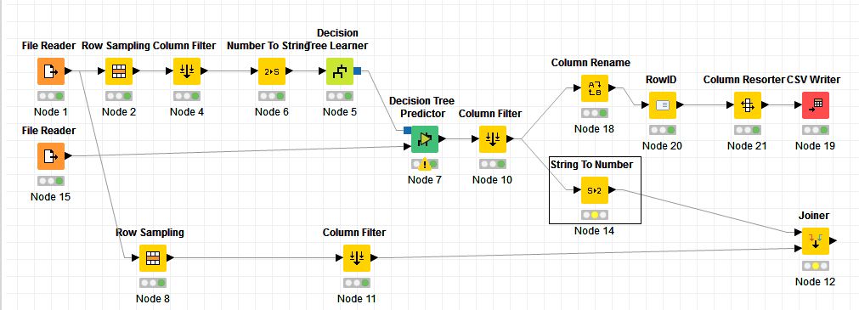
MODEL 4: RANDOM FOREST
Again, 100000 randomly selected training examples were chosen. This generated an LB score of 0.83028.
An improvement!

Slide 19
It's not who has the best algorithm that wins, It's who has the most data
- Andrew Ng
For all the models that have been described so far, we chose a small randomly selected sample from the training set and made predictions based on that sample. This was done to get quicker results. However, this resulted in a trade-off between time and accuracy. Quicker the result, poorer the accuracy. If suppose, we trained our data on the entire dataset for all the previous models, we could improve our prediction accuracy by as much as 30%! This will be evident in the next model.

Slide 20
MODEL 5: LOG MEANS – A SUMMARY
The most popular solution on Kaggle, this model makes predictions based on 1 criteria i.e., whether the data in the test set is present in the training set or not.
What this means is that, there are test examples which are somewhat identical to the ones in the training set. They might have the same ‘Producto_ID’, or the same ‘Producto_ID’ and ‘Agencia_ID’ or some other combination of the chosen features. If this is the case, then we predict the demand as equal to the demand in the corresponding training set.
There may be multiple hits for a test example in the training set, and to tackle this, we work in order of preference. A hit with 3 features common (say, ‘Producto_ID’, ‘Cliente_ID’, ‘Agencia_ID’) to both the test set and the training set is given preference over a hit with 2(or 1) features common.

Slide 21
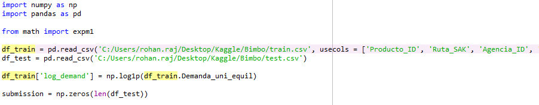
PYTHON CODE
This code snippet loads the data as a Pandas DataFrame. We can adjust the number of rows to be used from the training set using the ‘nrows = ###‘ argument. An additional column, which outputs the logarithmic demand of each example is added.

Slide 22
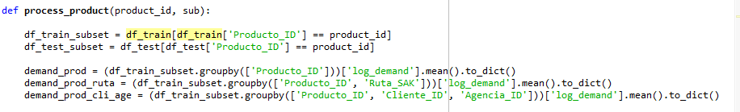
PYTHON CODE CONTD.
Next, we define a function which takes the product ID under inspection and the submission matrix as arguments. The next step is to group various features by mean for the particular example, which is then converted to a dictionary for faster results.

Slide 23
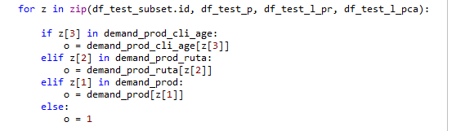
PYTHON CODE CONTD.
A for loop is run in zip format to iterate over multiple lists. As is visible, we have prioritized the demand value we want to work with, giving highest priority to the case where the ‘Producto_ID’, ‘Cliente_ID’ and ‘Agencia_ID’ match simultaneously. If no matches are found, we simply output a 1.

Slide 24
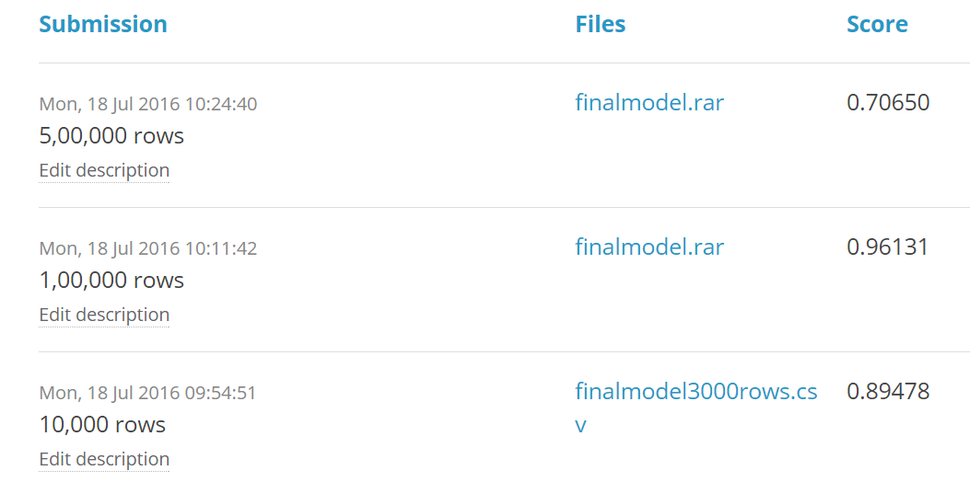
VARYING THE TRAINING DATA SIZE
As discussed earlier, we can significantly improve our performance by increasing the training set size. For the first submission, we chose just
10,000 rows which generated an LB score of 0.89478
1,00,000 rows which generated an LB score of 0.96131 (Yes, the model actually performed worse.)
5,00,000 rows which generated an LB score of 0.70650. Our best yet!

Slide 25
SUMMARY
Our training data has millions of examples and by using all of them to train the models, we can achieve LB scores as high as 0.48! This was barely scraping the surface of what can be done with the data we have at our disposal.
With more powerful computing and better algorithms we can do things that were a part of science fiction not too long ago!

